Slide 1
CSE 310 Software Engineering
UNIT I – Hour VI
FUNDAMENTALS OF SE AND REQUIREMENT ENGINEERING
Topic SRS, Prototyping & Formal Specification

Slide 2
Technically Speaking,
"requirement" ≠ "specification"
Requirement – understanding between customer and supplier
Specification – what the software must do
Requirements that are not in the SRS
  Costs
  Delivery dates
  Acceptance procedures
  etc

Slide 3
Uses of the SRS
Design
Validation
Customer Contract – rarely

Slide 4
Desired SRS Characteristics
Complete
Consistent
Changeable
Traceable

Slide 5
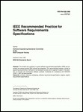
IEEE 830
Characteristics of a Good SRS
Unambiguous
Complete
Verifiable
Consistent
Modifiable
Traceable
Usable during the Operation and Maintenance Phase

Slide 6
IEEE 830
Role of SRS
“The SRS must correctly define all of the software requirements, not more than that.”
“The SRS should not describe design, verification, or project management details, except for required design constraints.”

Slide 7
Ambiguousness – example one
The total is taken from the last record.
The total is taken from the record at the end of the file.
The total is taken from the latest record.
The total is taken from the previous record.

Slide 8
Ambiguousness – example two
All customers have the same control field.
All customers have the same value in their control field.
All customer’s control fields have the same format.
One control field is issued for all customers.

Slide 9
Expressing Requirements
Through input/output specs
  IEEE 830 Format
Use of Representative Examples
Specification through Models

Slide 10
SRS Table of Contents
Introduction
  Purpose
  Scope
  Definitions
  References
  Overview
General Description
  Product Perspective
  Product Functions
  User Characteristics
  General Constraints
  Assumptions and Dependencies
Specific Requirements

Slide 11
3. Specific Requirements
3.1 Functional Requirements
3.1.1 Func Req 1
3.1.1.1 Introduction
3.1.1.2 Inputs
3.1.1.3 Processing
3.1.1.4 Outputs
3.1.2 Func Req 2
…
3.2 External Interface Requirements
3.2.1 User Interface
3.2.2 Hardware Interfaces
3.2.3 Software Interfaces
3.2.4 Communication Interfaces
3.3 Performance Requirements
3.4 Design Constraints
3.4.1 Standards Compliance
3.4.2 Hardware Limitations
3.5 Attributes
3.5.1 Security
3.5.2 Maintainability
3.6 Other Requirements
3.6.1 Database

Slide 12
Other Specification Techniques
Use Cases
Formal Specification Languages
  e.g. Petri Nets

Slide 13
Prototyping Definition
Prototyping is the process of quickly putting together a working model (a prototype) in order to test various aspects of a design, illustrate ideas or features and gather early user feedback.- Wikipedia
IEEE defines prototyping as “ A type of development in which emphasis is placed on developing prototypes early in the development process to permit early feedback and analysis in support of the development process.”

Slide 14
Need for prototyping
A potential foundation from which to continue developing the system
A vehicle for you to communicate the possible GUI design(s) of your system.
Enables us to explore the problem space with the stakeholders.
As a requirements artifact that enable us to initially envision the system.
As a design artifact that enables us to explore the solution space of your system.

Slide 15
Advantages & Disadvantages of Prototyping
Advantages | Disadvantages
Users can try the system and provide constructive feedback during development | Each iteration builds on the previous iteration and further refines the solution. This makes it difficult to reject the initial solution as inappropriate and start over.
An operational prototype can be produced in weeks | Formal end-of-phase reviews do not occur. Thus, its is very difficult to hold the scope of the prototype.
Users become more positive about implementing the system as they see a solution emerging that will meet their needs | System documentation is often absent or incomplete, since the primary focus is on development of the prototype.
Prototyping enables early detection of errors | System backup and recovery, performance, and security issues can be overlooked.
Reference: http://facpub.stjohns.edu/~wolfem

Slide 16
Journey of the Prototyping process
Functionality
Evaluate
Goals
Develop

Slide 17
Types of prototyping
Throw-away Prototyping
Evolutionary Prototyping
Low Fidelity Prototyping
High Fidelity Prototyping

Slide 18
Throw Away Prototype
Throw Away Prototype is developed from the initial requirements but is not used for the final project.
Written specifications of the requirements
Some developers believe that this type is a waste of time because you don’t use it.

Slide 19
Advantages & Disadvantages
Advantages | Disadvantages
Significantly reduce project risk | The prototype actually does nothing, its just presentational.
Has a short project timeline | Only for a limited purpose
 | Starting become a thing of the past. Not getting used as much now.

Slide 20
Evolutionary Prototype
Evolutionary prototyping is consider the most fundamental form of prototyping.
Evolutionary prototyping main concept is to build a robust prototype and constantly improve it.
Objective to deliver a working system to the end user.
According to Steve McConnell, "evolutionary delivery is a lifecycle model that straddle the ground between evolutionary prototyping and staged delivery."

Slide 21
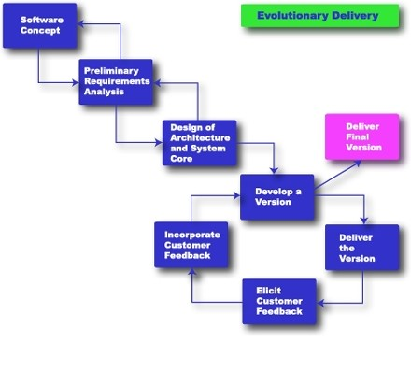
Evolutionary Delivery
Rapid Development, Taming Wild Software Schedules, by Steven McConnell, Press 1996

Slide 22
Advantages
You are always looking for new ways to improve the system.
This model increases the chance of having the client satisfied with the working system.
The model can be used even when the requirements are not defined.
Quicker delivery of the system

Slide 23
Disadvantages
This method avoids documenting the requirements of the system.
- Information can be lost through so many improvement
Management is required.
Long term maintenance can be expensive
Uncertain design idea’s

Slide 24
Low-fidelity Prototyping
Low-fidelity prototyping is generally called as limited function, limited interaction prototyping effort.
They are constructed to depict concepts, design alternatives and screen layouts. They are intended to demonstrate general look and feel of the interface.
They are created to educate , communicate and inform, but not to train, test or serve as a basis for which to code.
Low fidelity prototyping is used early in the design cycle to show general conceptual approaches without much investment in development.
Low vs. High Fidelity Prototyping Debate, Rudd J., Stern K.,Isensee S., ACM Interactions, Jan. 1996

Slide 25
High-Fidelity Prototyping
High-fidelity prototypes represent the core functionality of the products.
High fidelity prototypes are fully interactive systems. Users can enter data in entry fields, respond to messages, select icon to open windows and interact with user interface as if it were a real system.
They trade-off speed for accuracy.
Building high fidelity prototypes consume resources and high cost.
Low vs. High Fidelity Prototyping Debate, Rudd J., Stern K.,Isensee S., ACM Interactions, Jan. 1996

Slide 26
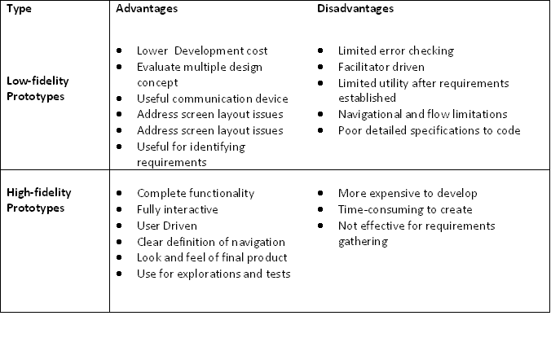
Comparison of two prototyping efforts
Low vs. High Fidelity Prototyping Debate, Rudd J., Stern K.,Isensee S., ACM Interactions, Jan. 1996

Slide 27
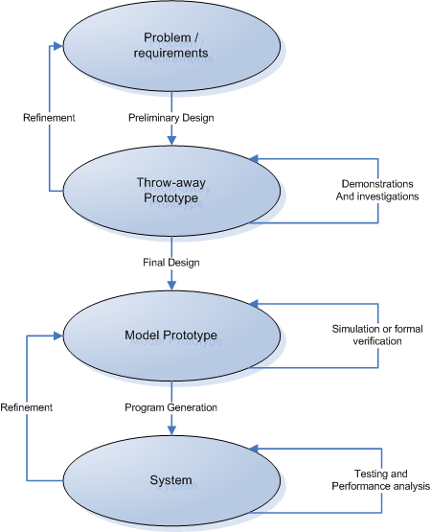
Prototyping-based Methodology
An Introduction to Rapid System Prototyping, Fabrice Kordon and Luqi, IEEE Transactions on Software Engineering, Vol.28, No.9, Sep 2002

Slide 28
Prototyping as methodology for systems development
A preliminary design of the system is built using throw-away prototyping.
Demonstrations to end users, as well as investigations on this prototype, allows for the design of more precise requirements as well as the evaluation of techniques to be used in the final system.
Refinements on throw-away prototype concerning the requirements are done.
Evolutionary prototyping used to build a model prototype (an accurate and complete description of the system). These prototypes can be studied under various simulated conditions.
Refinement on model prototype, concerning the actual system, is done and final system is rolled out after testing.

Slide 29
User Interface Prototyping
Development of highly interactive software system with graphical user interfaces (GUI) has become increasingly common need.
Prototyping is an excellent means of generating ideas about how the GUI can be designed and it helps to evaluate quality of solution at an early stage.

Slide 30
Classification of user interface prototypes
Presentation Prototypes
Functional Prototypes
Breadboards
Pilot Systems

Slide 31
Risks in Prototyping
Client may believe that system is real.
    Unrealistic expectations of the progress
Implementers make poor choice
    Justified in prototype but not in real system
    Tempting to build real system same way
Prototype is not identical to the real system
    Users may interact differently due to different response characteristics
    Must interpret prototype with experience and care

Slide 32
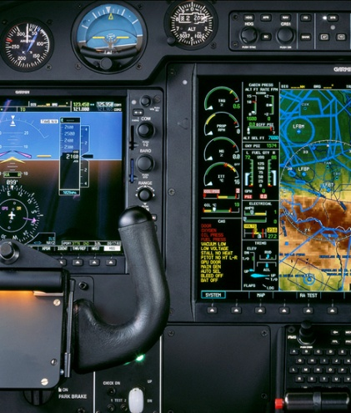
Do we need prototyping??
Two “points of interest” for companies to adopt prototyping based methodologies are:
Point 1: They allow us to reduce the cost and time-to-market of a system.
Point 2: For companies building critical systems, prototyping would help them perform formal verification when required. These methodologies provide high level of reliability in the system design and implementation.

Slide 33
Attributes and activities of a good software
Attributes:-
  Maintainability
  Dependability
  Efficiency
  Usability
Activities:-
  Software specifications
  Software design and implementations
  Software validation
  Software evolution

